Slide 1
Loop and Debug

Slide 2
TABLE OF CONTENTS
01
02
03
Python range() and for loop
For loop
While loop
04
Debugging techniques

Slide 3
01
range() function

Slide 4
What is a range() ?
Python built-in range() function generates the integer numbers between the given start integer to the stop integer
range(6)
0 | 1 | 2 | 3 | 4 | 5
6
Stop value (not included)
Start value (default is 0)

Slide 5
range(start_value, stop_value)
range() function use the first argument as the starting point for the list, the second argument will be the stop value (exclusive)
range(1, 8)
1 | 2 | 3 | 4 | 5 | 6 | 7
8
Start value
Stop value (not included)

Slide 6
range(start_value, stop_value, step)
The third argument specify the step the next number will be generated, if not provided, the default will be 1
range(1, 9, 2)
1 | 3 | 5 | 7
9
Start value
Stop value (not included)

Slide 7
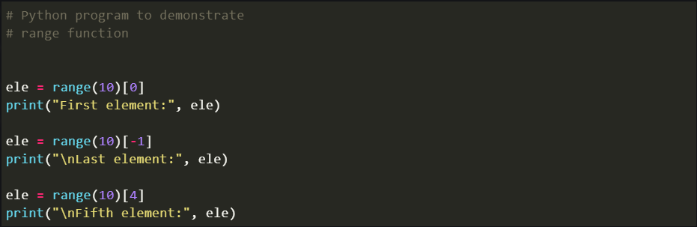
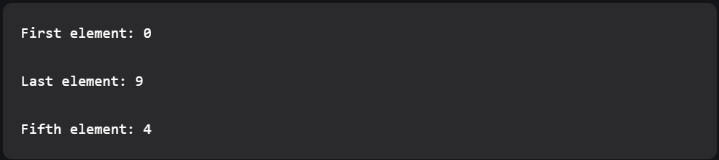
Accessing range() with index value

Slide 8
02
Loops

Slide 9
Why using loop?
When programming, we can see there are a lot actions that need to be repeated, typing them all will be a waste of time and resources
By utilizing loop, we can repeat the action many time with little code

Slide 10
Definite iteration
Infinite iteration
The number of times the designated block will be executed is specified explicitly at the time the loop starts
The number of times the loop is executed isn’t specified explicitly in advance. Rather, the designated block is executed repeatedly as long as some condition is met.
For loop
While loop

Slide 11
03
For loop

Slide 12
The for loop
Python for loop follows the syntax:
for var_name in <collection>:
<statements>

Slide 13
04
While loop

Slide 14
The while loop
The format of a while loop:
while <expression>:
<statement(s)>

Slide 15
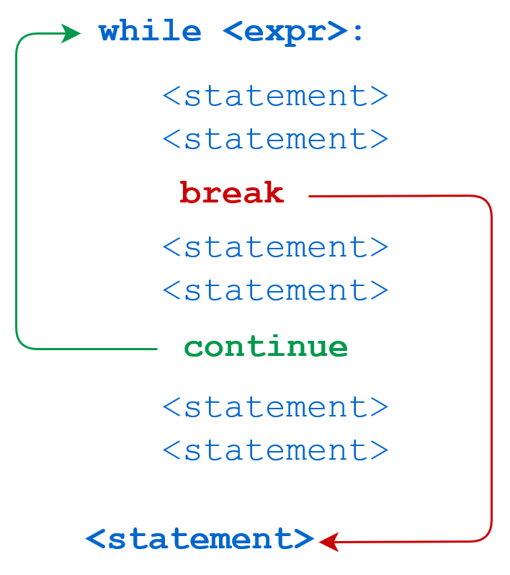
continue
break
immediately terminates the current loop iteration. Execution jumps to the top of the loop
Immediately terminates a loop entirely. Program execution proceeds to the first statement following the loop body.

Slide 16
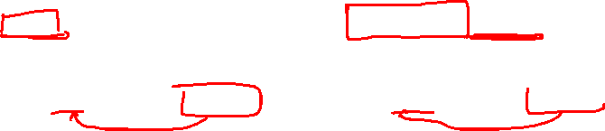
For loops vs While loops
For loops | While loops
Know number of iterations Can end early via break Uses a counter Can rewrite a for loop using a while loop | Unbounded number of iterations Can end early via break Can use a counter but must initialize before loop and increment it inside loop May not be able to rewrite a while loop using a for loop

Slide 17
05
Debugging techniques

Slide 18
Aspect of Language
Associates a meaning with each syntactically correct string of symbols that has no static semantic errors
Syntax
Semantics
Primitive constructs
Basic elements
Which string of characters and symbols are wel-formed
Static semantics
Defines which syntactically valid strings have a meaning

Slide 19
English
Python
Primitive constructs
Words
Syntax
“Cat dog boy”
Static semantics
“I are big”
Semantics
“Look at the dog with one eye”
=> <pronoun> <linking verb> <adjective>
=> <noun> <noun> <noun>
Ambinguous:
Primitive constructs
Number: 10, 3.2
Syntax
Expression: <object> <operator> <object>
Static semantics
3.2/’abc’
Semantics
Strings: “abcd”
Simple operators: +, /
There is only one meaning
a = 10
b 52

Slide 20
Errors
Program crashes, stops running
Program runs forever
Program gives an answer but different than expected

Slide 21
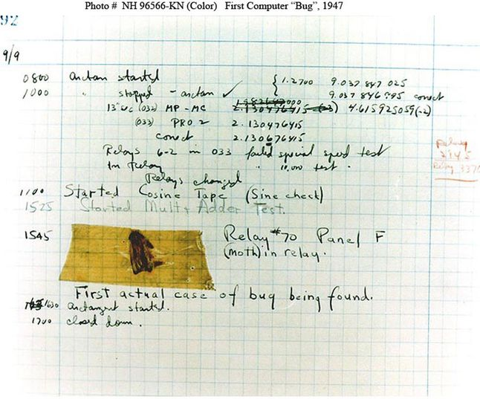

Debug story
Some have claimed that the discovery of that unfortunate moth trapped in the Mark II led to the use of the phrase debugging. However, the wording, “First actual case of a bug being found,” suggests that a less literal interpretation of the phrase was already common. Grace Murray Hopper, a leader of the Mark II project, made it clear that the term “bug” was already in wide use to describe problems with electronic systems during World War II.
And well prior to that, Hawkins’ New Catechism of Electricity, an 1896 electrical handbook, included the entry, “The term ‘bug’ is used to a limited extent to designate any fault or trouble in the connections or working of electric apparatus.”
In English usage, the word “bugbear” means “anything causing seemingly needless or excessive fear or anxiety.”
Shakespeare seems to have shortened this to “bug,” when he had Hamlet kvetch about “bugs and goblins in my life.”
The photo of a September 9, 1947, page in a laboratory book from the group working on the Mark II Aiken Relay Calculator at Harvard University.

Slide 22
Debug
Debugging starts when testing has demonstrated that the program behaves in undesirable ways.
Debugging is the process of searching for an explanation of that behavior.
The key to being consistently good at debugging is being systematic in conducting that search.

Slide 23
Debug steps
Studying available data (test results and program text)
Try to understand why one test worked and another did not.
Forming a hypothesis that you believe to be consistent with all the data.
Design and run a repeatable experiment with the potential to refute the hypothesis
Keep a record of what experiments you have tried.
“Insanity is doing the same thing, over and over again, but expecting different results”
When looking at the program text, keep in mind that you don’t completely understand it.
Narrow: “If I change line 402 from x < y to x <= y, the problem will go away”
Broad: “my program is not terminating because I have the wrong exit condition in some while loop.”
Put a “print” statement before and after each while loop. If these are always paired, then the hypothesis that a while loop is causing nontermination has been refuted.
Decide before running the experiment how you would interpret various possible results.

Slide 24
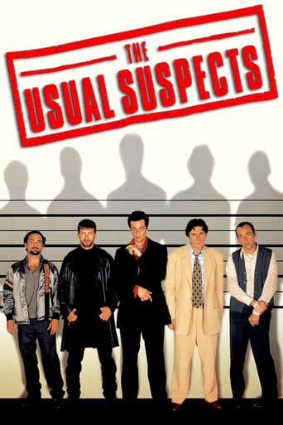

When the Going Gets Tough
Look for the usual suspect
-> Misspelled a name (lowercase/uppercase…)
-> Failed to reinitialize a variable
-> Forgotten that some built-in function has a side effect
…
Stop asking yourself why the program isn’t doing what you want it to. Instead, ask yourself why it is doing what it is.

Slide 25



When the Going Gets Tough
Keep in mind that the bug is probably not where you think it is.
-> If it were, you would probably have found it long ago
-> Sherlock Homes said: “Eliminate all other factors, and the one which remain must be the truth.”
Try to explain the problem to somebody else
-> Rubber duck debugging
Walk away and try again tomorrow

Slide 26
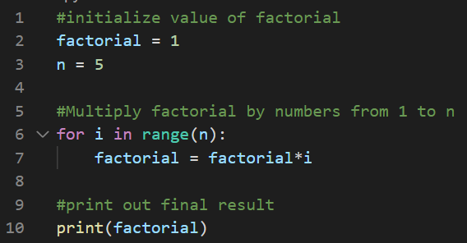
Visual Studio Code debugger
Find the factorial of a number n

Slide 27
THANKS!
See you in the next lesson!

